Slide 1
Twitter BY JAVA
Daniel Hanspeter 6129
Thomas Schievenin 5701

Slide 2
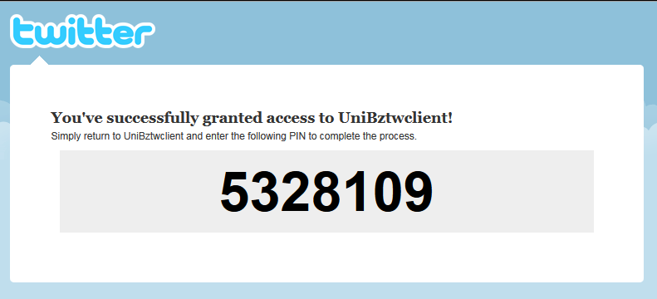
Exchanged data (1/3)
1. OAuth to grant access (SIGNPOST)
DEFAULTOAUTHPROVIDER
http://twitter.com/oauth/request_token
http://twitter.com/oauth/access_token
http://twitter.com/oauth/authorize
RetrieveRequestToken
Authentication URL
RetrieveAccessToken(PIN)
TOKEN
SECRET
&

Slide 3
Exchanged data (2/3)
2. GET / POST REQUEST WITH RESPONSE
Open HTTP Connection (URL)
Request
SIGN with Consumer
Send request
DEFAULTOAUTHCONSUMER
Application’s Key and Secret
User’s Token and Secret
XML

Slide 4
Exchanged data (3/3)

Slide 5
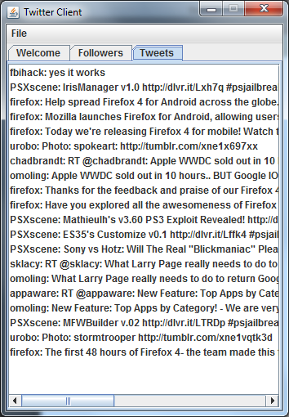
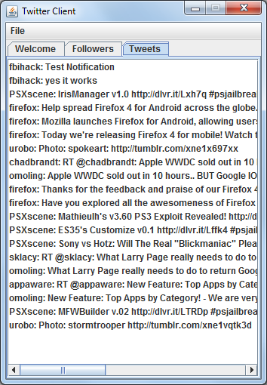
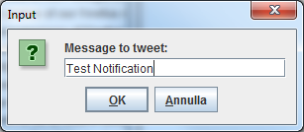
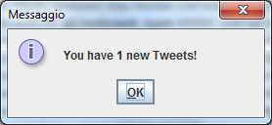
Workflow

